Slide 1
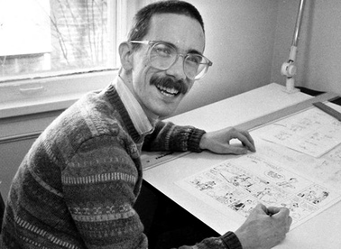
Bill Walterson
By.jacob b.

Slide 2
Apr 27 1958
Bill Watterson Was Born
•◀
Apr 27 1964
Watterson Moves to Ohio with his family.
•◀
Apr 27 1976
Watterson enrolls in Ohio's Kenyon College
•◀
Apr 27 1980
Watterson graduates college.
•◀
Apr 27 1985
Signed on with Universal press syndicate to produce Calvin and Hobbes.
more
•◀
Nov 27 1985
Battles with companies wanting to merchandise Calvin and Hobbes.
•◀
Apr 27 1986
Watterson earns National Cartoonists Society’s Reuben Award.
more
•◀
Apr 27 1995
Watterson ends Calvin and Hobbes on December 31st of 1995 after ten years of running the comic.
•◀
Apr 27 2004
Watterson moves to Cleveland Heights Ohio.
more
•◀
Feb 26 2014
February 26, 2014 Watterson publishes first comic since the end of Calvin and Hobbes
more
•◀
Apr 27 1958Apr 27 2014
Bill Watterson's Life
•◀
Apr 27 1976Apr 27 1980
Low point in Watterson's career.

Slide 3
Apr 27 2004
Watterson moves to Cleveland Heights Ohio.
more
•◀
Feb 26 2014
February 26, 2014 Watterson publishes first comic since the end of Calvin and Hobbes
more
•◀
Apr 27 1958Apr 27 2014
Bill Watterson's Life
•◀
Apr 27 1976Apr 27 1980
Low point in Watterson's career.

Slide 4
Calvin and Hobbes

Slide 5
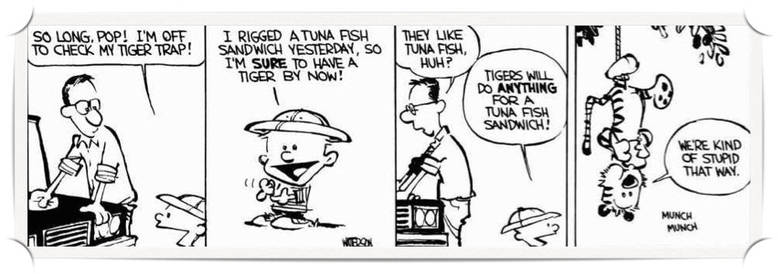
First strip
The first strip was released in 1987

Slide 6
